Slide 1
A Major Project Proposal Defense Presentation

Slide 2

NEURONEX: AN IMMERSIVE LEARNING EXPERIENCE
Presented By :
Shreeyansi Shrestha (KAT077BCT078)
Rejina Dangol (KAT077BCT057)
Sneha Thakur (KAT077BCT086)
Wagmi Dahal (KAT077BCT096)

Slide 3
Slide Overview
Introduction
Problem Statement
Objective
Scope and Applications
Literature Review
Existing Systems
Limitations of Existing System
Solutions Proposed By Our System
Methodology
System Block diagram
Flowchart
Tools to be used
NEURONEX: AN IMMERSIVE LEARNING EXPERIENCE

Slide 4
Expected Outcome
Gantt Chart
References
Bibliography
NEURONEX: AN IMMERSIVE LEARNING EXPERIENCE

Slide 5
1. Introduction
Augmented Reality (AR) is a digital technology that connects computer-generated material to real-world experiences, making them more engaging.
Purpose: improve education by delivering dynamic, engaging, and realistic simulations that help students grasp and remember complicated subjects.
Mission: provide students with a fun and visualised approach to learning.
Vision:develop a dynamic, 3D learning environment where students can grasp and remember challenging subjects by bringing theory to life.

Slide 6
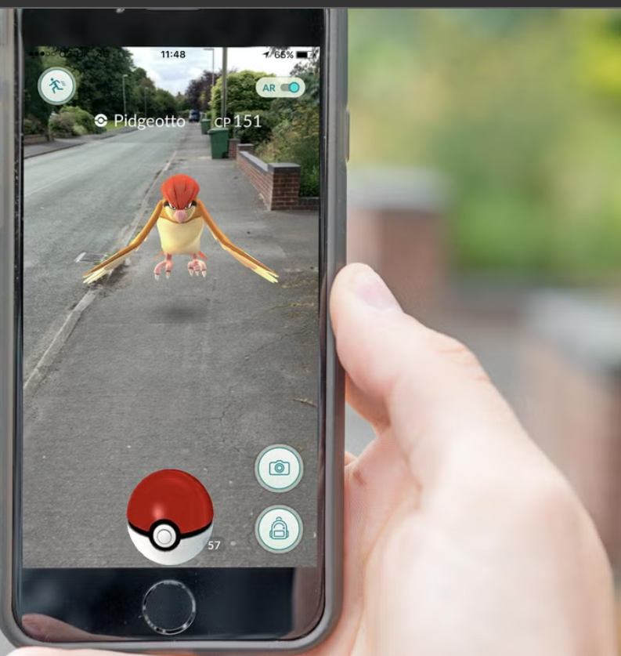
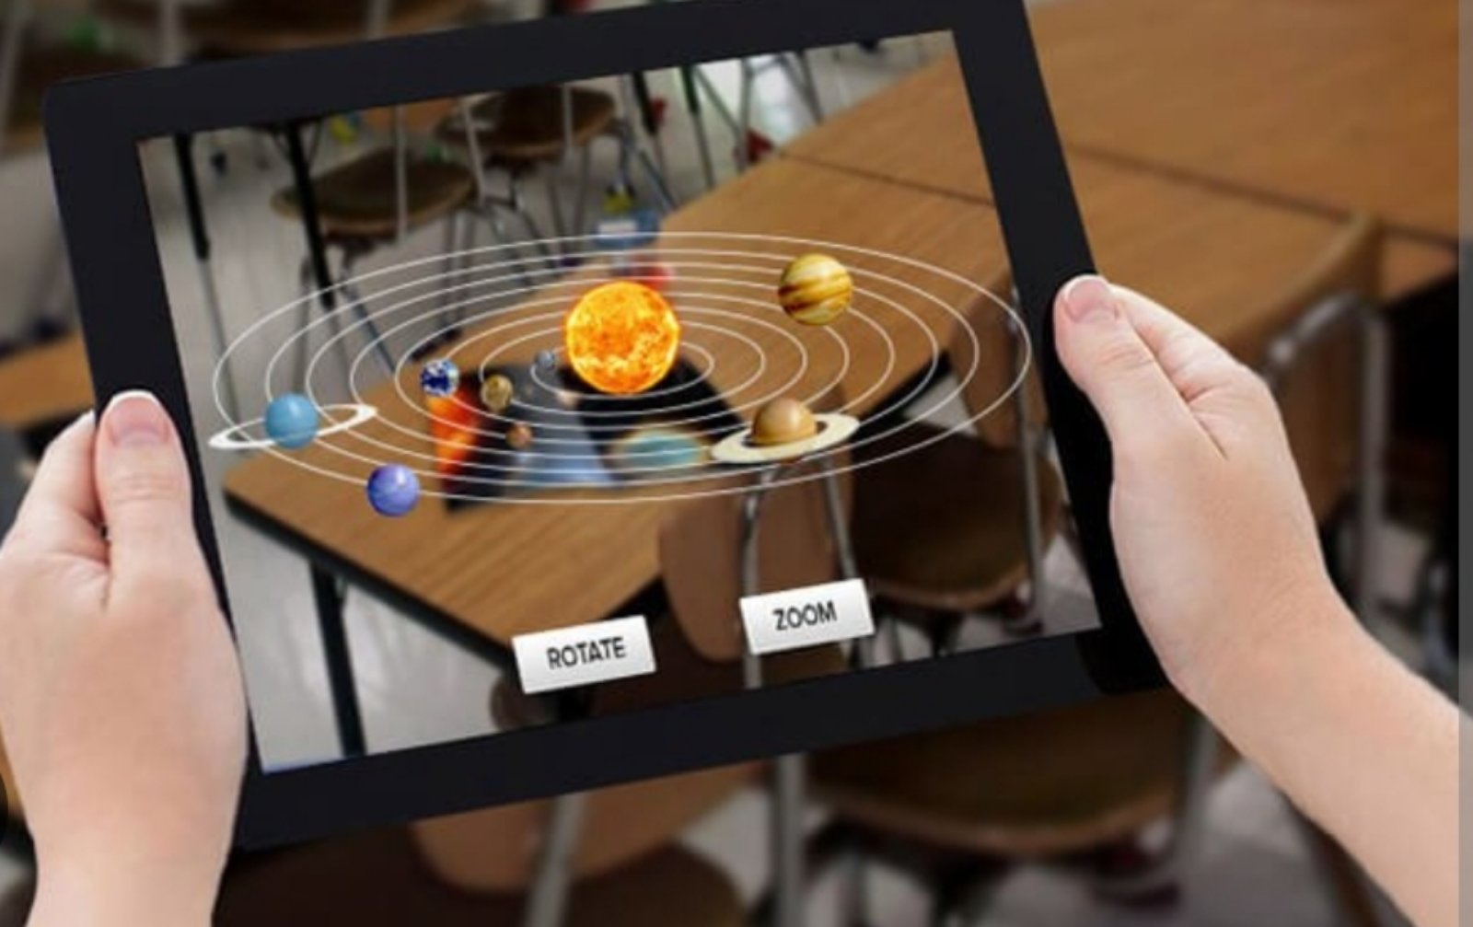

Slide 7
1.1 Problem Statements
Conventional teaching methods, mainly lectures and static videos, struggle to engage and maintain attention
Lack of interactive application for students facing academic challenges

Slide 8
1.2 Objective
To engage students with learning differences like ADHD, Autism in a more interactive and flexible learning approach.
To help students better remember and understand information by providing a visual and hands-on approach to learning by using AR approach.

Slide 9
1.3 Scope and Application
Provides an interactive environment for the students with learning differences.
Personalizes learning experiences based on individual preferences and proficiency levels, catering to diverse learning styles and needs.
Provides hands-on learning experiences that engage multiple senses, improving retention and comprehension compared to traditional methods.
Provides a better understanding of the core concepts of mathematics with an animated version of the core concepts at a basic level.

Slide 10
2. Literature Review
STUDY | FINDINGS
Azuma et al. (2001) | AR enhances users' perception and interaction with the real world by integrating 3D virtual objects seamlessly within the real-world environment.
Hughes et al. (2005) | AR technologies can interact through various sensory channels, indicating that definitions focusing only on visual data are insufficient for future AR developments.
Billinghurst (2002) | AR has vast potential for education, enhancing teaching and learning environments by making learning more engaging, stimulating, and motivating.
Shelton & Hedley (2002) | AR can effectively teach subjects like the earth-sun relationship where real-world first-hand experience is not feasible, enhancing understanding through interactive simulations.

Slide 11
STUDY | FINDINGS
Kerawalla et al. (2006) | AR engages students and helps them explore class materials from different angles, improving retention and understanding.
Klopfer & Yoon (2004) | AR fosters student creativity and imagination by creating authentic learning environments suited to various learning styles.
Hermawan & Mochamad (2015) | Developed an Android application using AR to display 3D brochure models, aiding users in selecting campuses more effectively.
Sartika (2016) | Created an Android-based AR application for teaching the solar system to 6th-grade students, providing animated images and descriptions that improve understanding of planetary circulation and characteristics.

Slide 12
2.1 Existing Systems
Assemblr Edu: explore and interact with static 3D content
Brilliant: 2D animation for STEM content
NEURONEX: AN IMMERSIVE LEARNING EXPERIENCE

Slide 13
2.2 Limitations of Existing System
Current systems do not support interactive learning through visualizations using 2D and 3D animations.
These systems only allow models to be manipulated through tap and drag capabilities.
Users require a reliable internet connection and compatible devices to access these systems.
NEURONEX: AN IMMERSIVE LEARNING EXPERIENCE

Slide 14
2.3 Solution Proposed By Our System
Augmented reality to be used in order to enhance understanding of complex subjects through visualizations and simulations.
AR educational content that is embedded and can be accessed without an internet connection.
NEURONEX: AN IMMERSIVE LEARNING EXPERIENCE

Slide 15
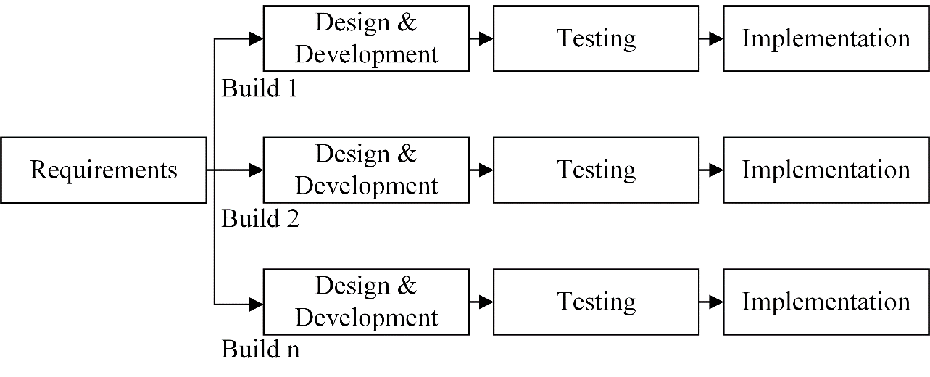
3. Methodology
Incremental model
Figure 3: Block diagram of Incremental model

Slide 16
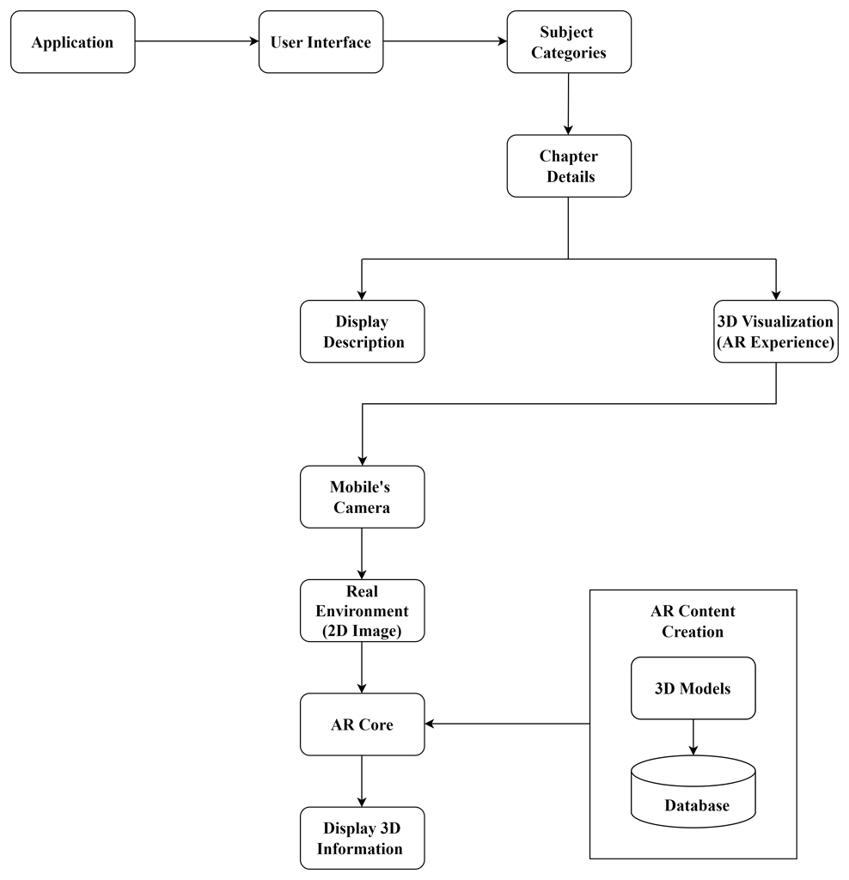
3.1 System Block Diagram
Figure 3.1: System Block diagram
NEURONEX: AN IMMERSIVE LEARNING EXPERIENCE

Slide 17
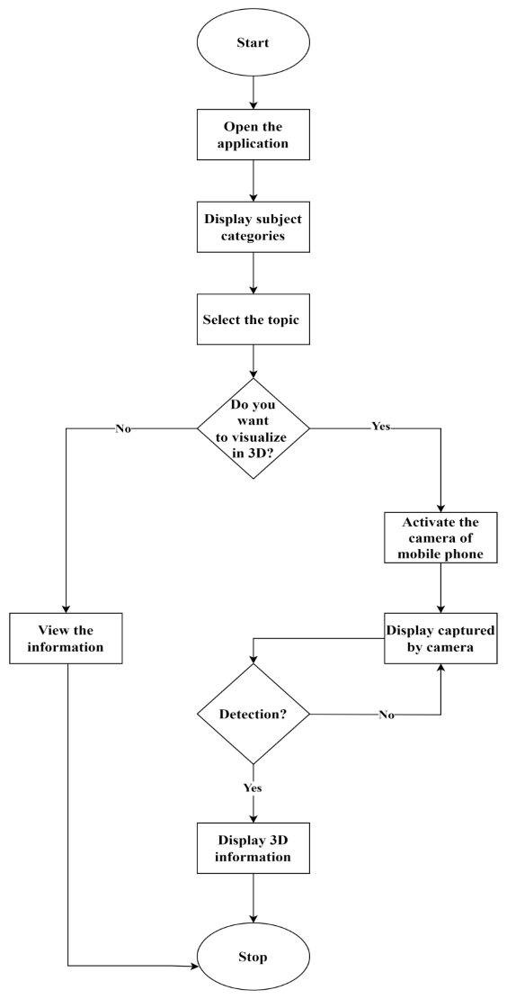
3.2 Flow Chart
Figure 3.2 : Flowchart

Slide 18
3.3 Tools to be used
Dart
Flutter
Firebase
Android Studio / Unity
Google AR Core
Blender
Git
NEURONEX: AN IMMERSIVE LEARNING EXPERIENCE

Slide 19
4.Expected Outcome
An augmented reality and animations based app that is targeted to children ( mid-school) of all learning differences.
Provides concept visualization and a fun way to learning process with innovative technology.

Slide 20
4.1 Gantt Chart

Slide 21
5. References
[1].Azuma, R., Baillot, Y., Behringer, R., Feiner, S., Julier, S., & MacIntyre, B. (2001). Recent advances in augmented reality. Computers & Graphics, 1-15.
[2].Hughes, C. E., Stapleton, C. B., Hughes, D. E., & Smith, E. M. (2005, November/December). Mixed reality in education, entertainment, and training. IEEE Computer Graphics and Applications, 24-30.
[3].Billinghurst, M. (2002). Augmented Reality in Education. New Horizons for Learning, December 2002. Retrieved July 20, 2010 from http://www.newhorizons.org/ strategies/technology/billinghurst.htm
[4].Shelton, B. E., & Hedley, N. R. (2002). Using augmented reality for teaching earth-sun relationship to undergraduate geography students. The First IEEE International Augmented Reality Toolkit Workshop (pp. 1-8). Darmstadt, Germany: IEEE.
[5].Kerawalla, L., Luckin, R., Selijefot, S., & Woolard, A. (2006). Making it real: Exploring the potential of augmented reality for teaching primary school science. Virtual Reality, 10(3-4), 163-174.
[6].Klopfer, E., & Yoon, S. (2004). Developing games and simulations for today and tomorrow’s tech savvy youth. TechTrends, 49(3), 41-49.
[7].Hermawan and Mochamad. 2015. \"Using Augmented Reality as Information Media.\" National Seminar on Information and Communication Technology 2015
[8].Sartika. Y, Telnoni, P, A, and Tambunan, T. D. 2016. \"The Application of SurYes Learning for Science in Grade 6 Elementary Schools Using Augemented Reality Based on Android\". E-Proceeding Of Applied Science, 895.

Slide 22
6. Bibliography
Yildiz, E. P. (2021). Augmented Reality Research and Applications in Education. IntechOpen.
Koumpouros, Y. (2024). Revealing the true potential and prospects of augmented reality. Smart Learning Environments.
Koti, A. (2023). The Use of AR in Secondary Education. Scientific Research Publishing.
Ramos-Hurtado, J. (2022). Proposal for the Deployment of an Augmented Reality Tool. MDPI.
Annotated Bibliography – Virtual Reality/Augmented Reality. (n.d.). Texas A&M University System.
Cubo Kids: A Proposal for an Educational Application with Augmented Reality. (n.d.). ResearchGate.
www.sciencedirect.com/science/article/abs/pii
www.researchgate.net/publication/The Role of Location-based Augmented Reality in Enhancing Visit Intention of Cultural Heritage Site
NEURONEX: AN IMMERSIVE LEARNING EXPERIENCE

Slide 23
Thank you
NEURONEX: AN IMMERSIVE LEARNING EXPERIENCE

